Slide 1

STUDENT ONLINE RISKS
WEEK 4

Slide 2

What is an Online risk?

Slide 3
An online risk is anything that can cause harm or damage to a computer user while online.
Risks can result to a computer user being hacked and their information being stolen or altered.

Slide 4
Common Online Risks Faced By Students
Exposure to Inappropriate Material such as pornography.
Cyberbullying
Giving out personal information online
Online Scams
Cyber Predators
Cyber-attacks through phishing or accidental malware download.

Slide 5
Research: EU Kids Online
According research conducted by EU Kids Online, children in different parts of Europe were asked mention what makes them uncomfortable when they are online.
Some of the responses were;
Strangers messaging them
Violence
Sexual content
Photos of them being taken without their consent.

Slide 6
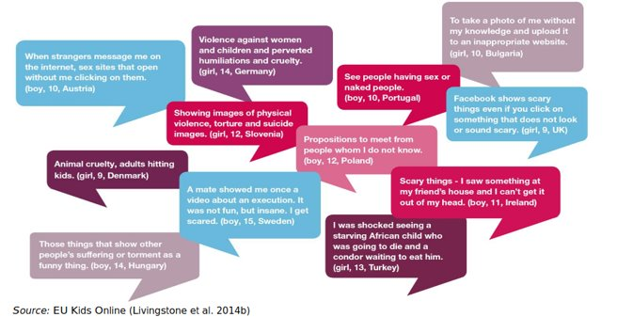
The image below shows some of the responses from children around Europe.

Slide 7
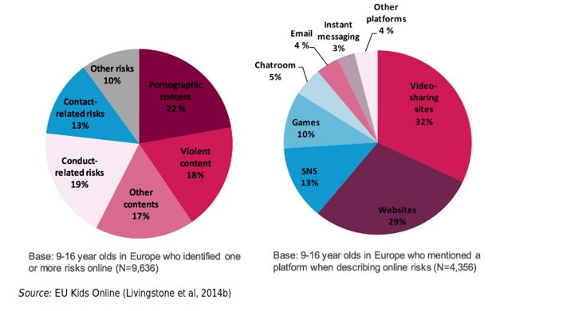

Slide 8
Indicators of student facing online abuse
A student may be experiencing online abuse if he or she has the following behaviours:
Spends most his or her time online; texting people, social media or gaming.
Hides who they interact with in the internet through texts, calls or even emails.
Shows withdrawal signs after using the internet.
Notes:
Parents, guardians and teachers should study behaviours of students while online to identify if the student is facing any kind of online abuse.

Slide 9
Topic Reflection
Common activities that have bothered children online
Identification of student online risks
Definition of Student Online Protection
Indicators of student facing online abuse

Slide 10

THE END

