Slide 1
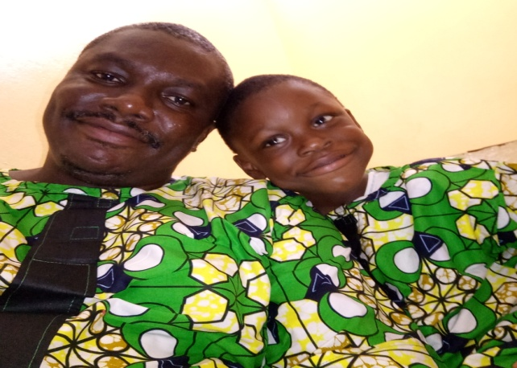
Prince C. Brainard
I earned my Master of education degree from Fourah Bay College, University of Sierra Leone. I was working and at the same time studying.
I happy to participate in this most educative and interactive forum for Teacher Futures programme supported by Commonwealth of Learning. Its an opportunity for me to learn from others.
Looking forward to collaborating with you all. God bless!
I am a Sierra Leonean . I work at Freetown Teachers College., as the Planning Officer and Focal Person for Performance Management Contracts. I am engaged in preparing strategic plans for the college, prepare and review the college’s service delivery charter, participate in administrative decision making processes of the college, advice administration on administrative matters. Monitor and evaluate staff performance and projects undertaken by the college. I am also the project contact Person for Freetown Teachers C ollege–COL projects.

