Slide 1
Week 3: Participating and contributing online
C-DELTA Training of Trainers online course

Slide 2
Learning Outcomes
Review your existing learning networks
Expand your digital networks
Understand your position as a digital education leader
Identify gaps and opportunities in your own context where you can make a contribution
Understand how you can contribute to changes in digital education
Identify how forming part of a network helps to build capacity.
Notes:
As we move into week 3 the learning outcome for the week move from understanding and analyzing to expanding and creating. We start by reflecting on the value of networks and how you can expand yours to identifying areas in your context where you, as a digital education leader, can make a contribution. You will move towards identification of a gap or opportunity where you as a DEL can make a contribution and draw on your PLN to support and guide you in this process. You will then develop a draft plan/ idea for how you can use digital technologies to address or assist with this gap or opportunity.

Slide 3
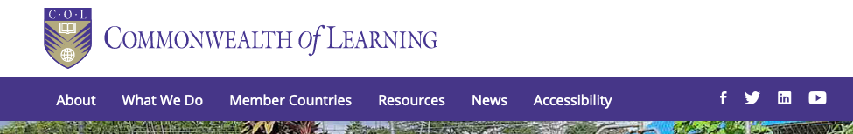
Your Personal Learning Network
Where to follow?
  Twitter, Facebook, LinkedIn, YouTube
Who to follow?
  “Rock stars” of your discipline
  People who attend the same conferences you do
  From a list provided to you by others
Notes:
In week 2 you will have already reflected on your existing Personal Learning Network . The video you have just watched gives you some quick and simple ideas for how to expand this.
We know people have different social media channels they use in different countries. What do colleagues in your country use? COL has a presence on a range of social media channels namely twitter, facebook, LinkedIn and Youtube which you can see on their website. Most likely other organizations that you hold in high regard will have a social media presence as well.
This is one place to start. You can also follow what can be called “rock stars” of your discipline, or people who you meet at conferences or ask your colleagues who they follow.

Slide 4
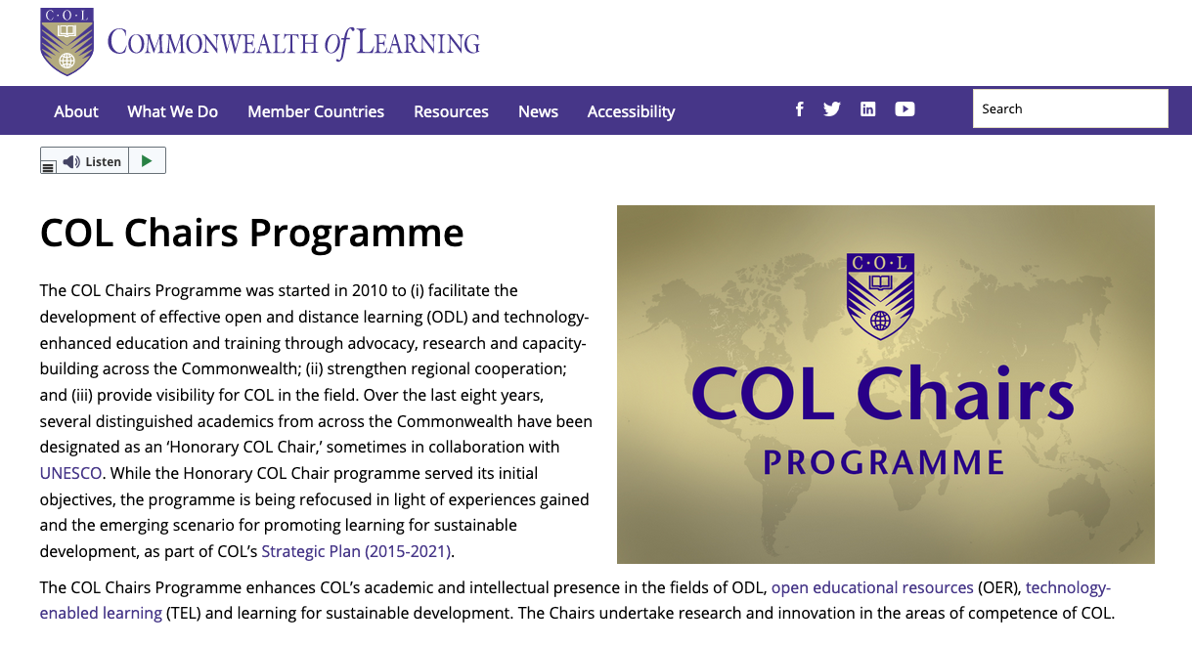
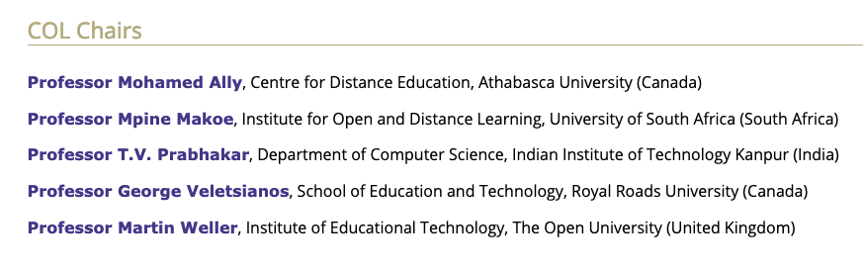
Notes:
As a start why not have a look at the COL Chairs (which you can also find on their website) and follow them. Col Chairs come from all over the world and you may already be familiar with some of these name?
But a word of caution. Have you heard of the English expression “Birds of a feather flock together” ...in the context of your PLN you need to be careful of only following “birds of a feather”. Don’t just follow people you know, or people from your country or discipline. Branch out to other people and groups for new ideas.

Slide 5
Engaging with (and building) networks (for Learning)
People connected by interest not by geography.
“It’s like sitting around a big table [with the experts] 24/7”
Purpose
  Get advice
  Share resources
  Share knowledge and skills
  Professional development (or personal)
  Collaborate
Information overload
  Need to start curating/aggregating the incoming information (but careful because mashup services can come and go)
Notes:
One of the great things about a PLN using social media is that you can follow people with the same interests as you and are not limited by geography.
You might find all kinds of valuable opportunities when you start engaging with your network. Remember – as the video you watched at the start suggested ….. It’s not just about getting advice and looking for ideas. A PLN is a place where you can give back and share your resources and knowledge and skills. It can also be a great space to find people to collaborate with.
But one of the challenges is how to deal with all that information that you get. You might need to find a way to curate this so you don’t loose track of all those good ideas.

Slide 6
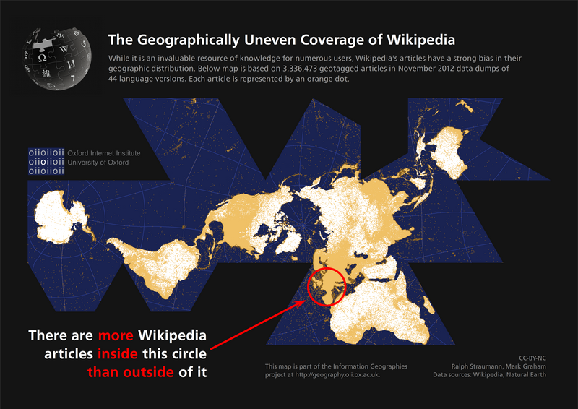
Inequality in participation
https://whoseknowledge.org/issues/public-online-knowledge/
Notes:
Here are a few other ways of visualizing the disparity in internet coverage . There are more Wikipedia authors in the tiny red circle (which covers Europe) than anywhere else in the world
And ….
research from whoseknowledge.org reports that only 20% of the world (primarily white male editors from North America and Europe) are responsible for 80% of Wikipedia contributions currently, with only 1 in 10 of the editors self-identifying as female.

Slide 7
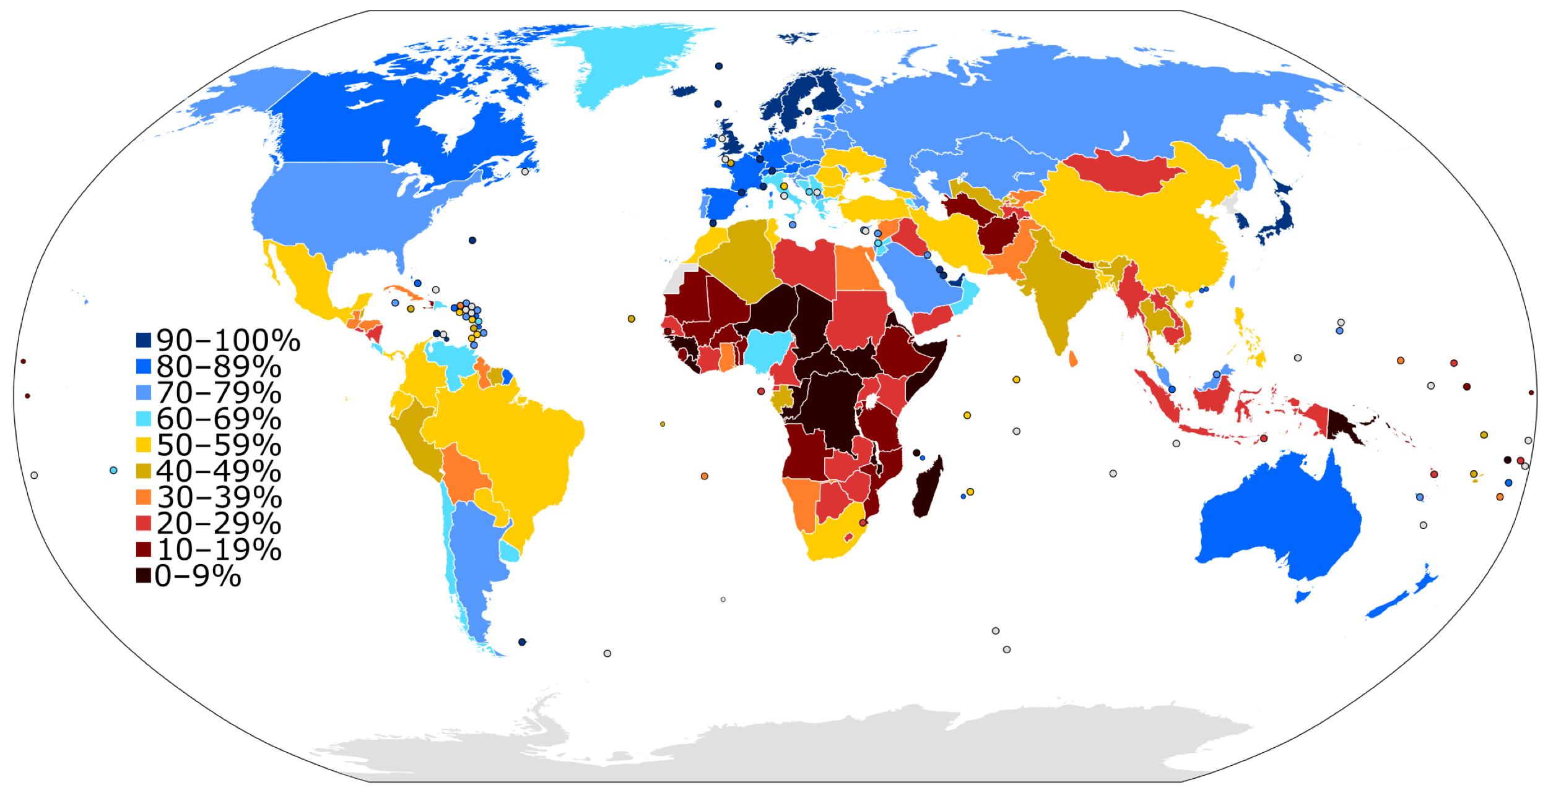
Who is represented in digital spaces and who isn’t?
https://commons.wikimedia.org/w/index.php?curid=19202338
Notes:
This diagram draws on data from the International Telecommunications Union (ITU) from 2016 and gives you a visual representation of global internet users. The dark black and maroon colours are where there are the least internet users per percentage of a country's population whilst the blue areas show the most users. What this demonstrates is the inequality which exisits globally in access to and use of the internet

Slide 8
“We”, who is we? ... who are “You”
“We” .... We could be the people in this room but it could also be your organisation, your community, your government
“You” .... your digital identity is actually situated in communities, cultures, regions, and ultimately, a global political and informational field of ‘the digital’. So as an individual you could perform certain role(s) - i.e. student, teacher, policy maker – but these roles only makes ‘sense’ in relation to, in context to social spaces and institutions (e.g. education, schools, community organizations, governments, etc)
Notes:
What we are looking to achieve here is an understanding that each of us is a product of our own context, history, environment (we filter information through these lenses)
The C-DELTA curriculum is based on a view of digital education leadership as being a situated learning practice. That means that your context is critical to how you view and do things
So it’s important to think about who You are in relation to your context that is the role you occupy professional and who “we” are in relation to your context ie the places in which you live and work.

Slide 9
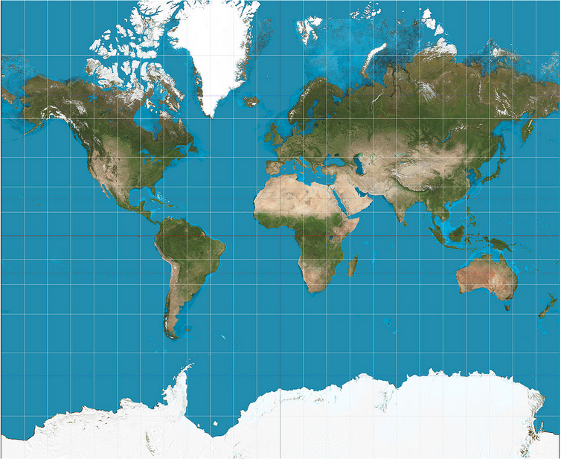
So what happens if You or We don’t contribute to online content?
https://commons.wikimedia.org/wiki/File:Mercator_projection_Square.JPG
Notes:
So most people are probably familiar with this map of the world. Its called the Mercantor map and is the most popular or dominant way of depicting our world graphically. It was created in the mid 1500 by a Belgium cartographer
But is this what the world really looks like?

Slide 10
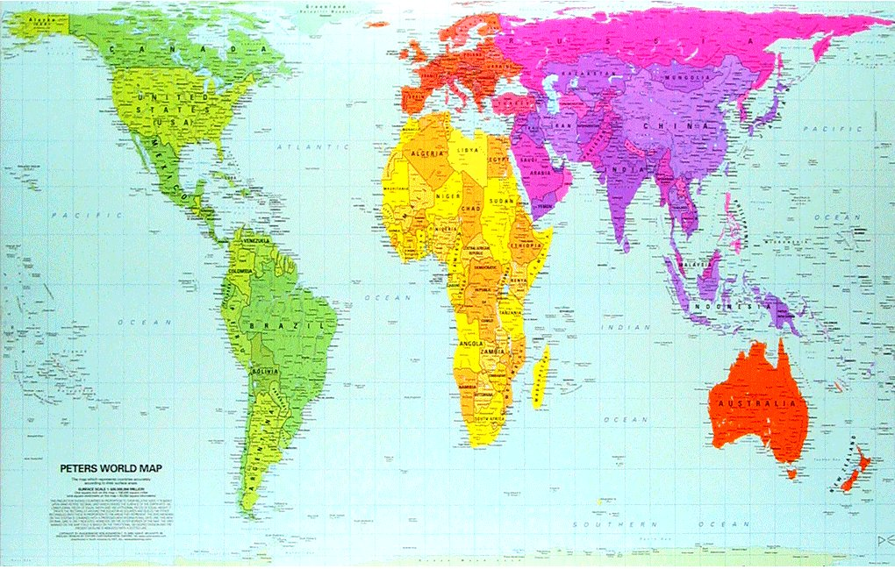
The landmasses on Earth look more like this
https://www.flickr.com/photos/perrenque/3637826893
Notes:
But actually the landmasses of the world look more like this. Peters map was first introduced by historian and cartographer Dr. Arno Peters at a Press Conference in Germany in 1974 it generated a firestorm of debate. The first English-version of the map was published in 1983, and it continues to have passionate fans as well as staunch detractors.
Mercator’s map inadvertently also pumps up the sizes of Europe and North America. Visually speaking, Canada and Russia appear to take up approximately 25% of the Earth’s surface, when in reality they occupy a mere 5%.

Slide 11
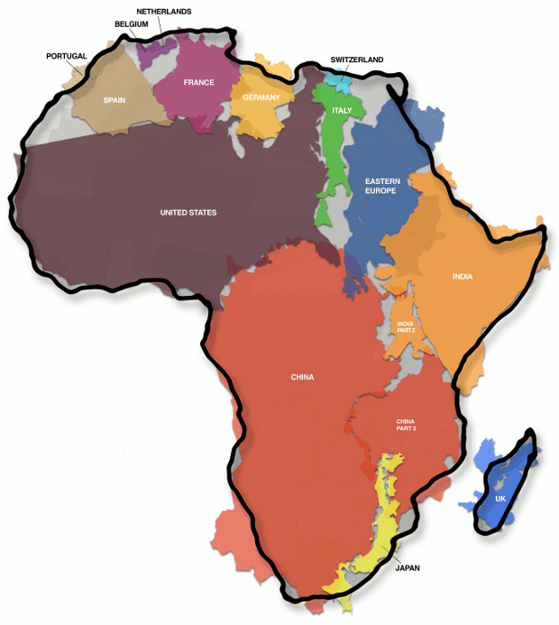
The real size of Africa
https://commons.wikimedia.org/wiki/File:Afrika-real-size.png
Notes:
Just look how big Africa is in this depiction
Do you think the majority of US & European citizens (the main producers of online content) care that the view of the size of Africa as depicted in most common used maps is completely incorrect?
. The Mercantor map continued use of this style of map gives users a warped sense of the true size of countries – particularly in the case of the African continent. Unless “we” and “you” start to challenge the dominant paradigms the Northern view of world will remain the loudest voice. Just like we saw in the Wikipedia edit image
This is one of the reasons why as Digital Education Leaders you need to do more than just be able to use digital technology well for educational purposes. What you need to do is be able to create digital technology for education and share your knowledge and skills and ideas in order to make sure you and your community have a voice on the the internet.

Slide 12

It’s not enough to just survive but also to thrive
….through Participation and Contribution
https://commons.wikimedia.org/wiki/File:Prosumers-and-customer-service.jpg
Notes:
As internet access increases and smart hones enable greater access to the internet, more and more people will be able to access information online. Ie more people will consume information online. What sets you apart as DEL’s is that you will be participating and contributing online. You will be a producer of knowledge.
This is a way that you can influence all those maps and charts that we have been looking at. By putting your organization/

Slide 13

Thank You
© Commonwealth of Learning, 2020. Available in Creative Commons Attribution-ShareAlike 4.0 International license to copy, remix and redistribute with attribution to the original source (copyright holder), and the derivative is also shared with similar license.

