Slide 1
Week 2: Improving your search strategies
C-DELTA Training of Trainers online course

Slide 2
Learning Outcomes
improve your personal online search strategies
identity, analyse and assess online resources
Notes:
This week we are exploring strategies to help you improve your skills and strategies in searching for and finding online information. You also need to when you are allowed to use online resources and the benefits of open education resources.

Slide 3
Access & online resources
“Finding the wrong information is just as easy as find the right information.
The same principle applies to available resources: finding applicable resources might be easy, but finding the right resource for you and for in your context, isn’t necessarily easy and can be quite challenging. “
Notes:
In this session we are going to think about the process of doing an online search. If you want to look for more information about this topics then Module 4 in the C-Delta curriculum covers it well.
As we discovered last week, most people across the world use Google as a search engine. This has become such common practice that often you might hear someone say “Oh I’ll just Google that”. But Google as we now know is only one example of a search engine and what people should more correctly say is “I will search that onine”.
But when you search online, is it always easy to find what you are looking for? Sometimes finding the right resources that has just the right level and type of information is harder tha it seems.

Slide 4
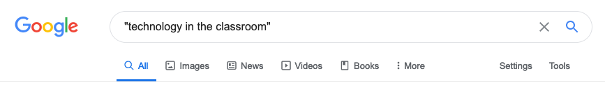
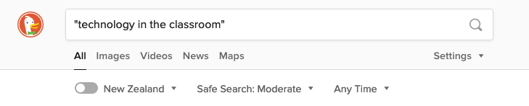
How to access online resources.
Notes:
Lets use Google to search for the term “technology for the classroom”. Remember to use the “quotation marks so the search engine knows to look for the exact phrase.”
I am going to show a screen shot of my personal search. But you try your own and see what is similar of different. Maybe also try and use another search engine – one we talked about last week). Remember it is highly unlikely that we will all return the same results. Can you remember why that is? Search engine like google (and many other companies and systems eg Apple) use a system to find out where you are connecting to the internet from. The information you see will be altered depending on your location. Also because many websites use cookies, your searching activity is recorded and as a result the information you get when you go to places or do an online search is customized based on your previous activity online.

Slide 5
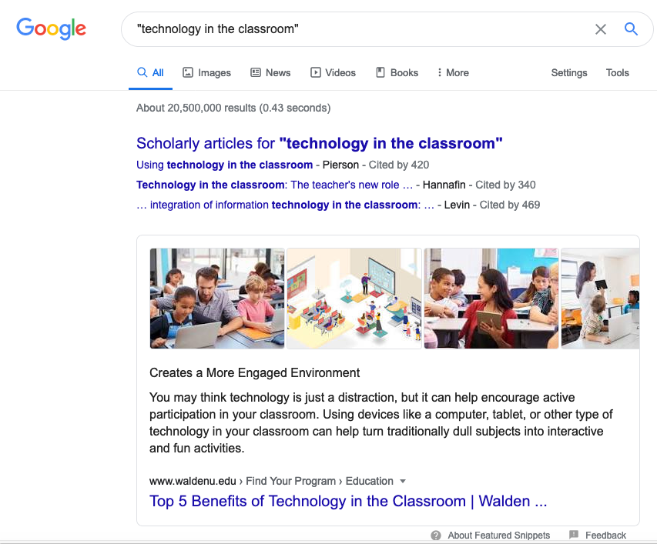
Notes:
This is a screen shot of my search
There are over 20 million results. The first options I get are scholarly articles.
The first result is not necessarily the most relevant through.
1st result are based on the number of links to/from other websites in the page so really first could be popular or also could be because the website owner/ organisation has paid for the website to be featured on other pages.
Usually a search return ALL results but as you can see at the top of the page you can search by different types of media such as images, vide, news etc.

Slide 6
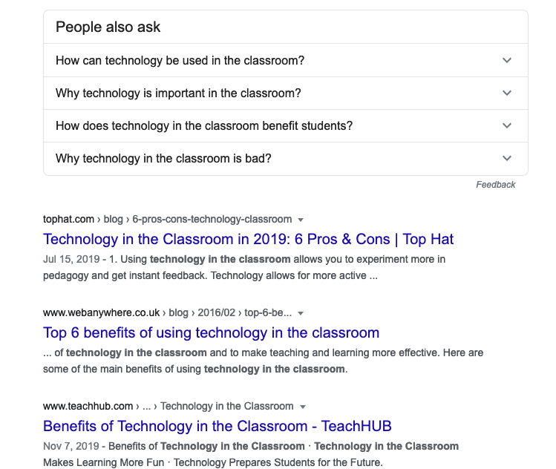
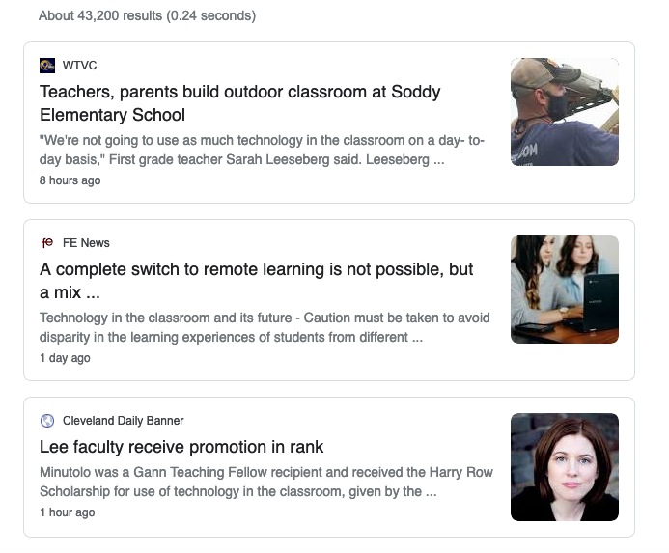
Notes:
The next part of what I see on a search page is what other people asked. The search engine is trying to “clever” for me and suggest other search phrases
If I click on news then you re likely to get news that is most recent on your topic You can see that these are news items from as early as 1 hour ago to 8 hours to 1 day ago. .

Slide 7
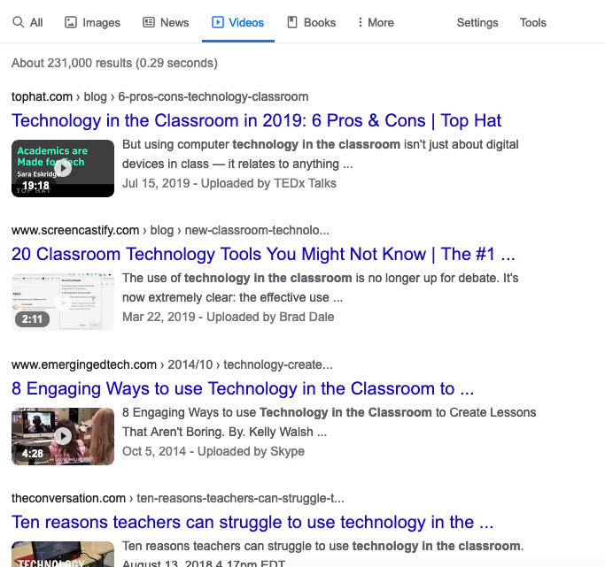
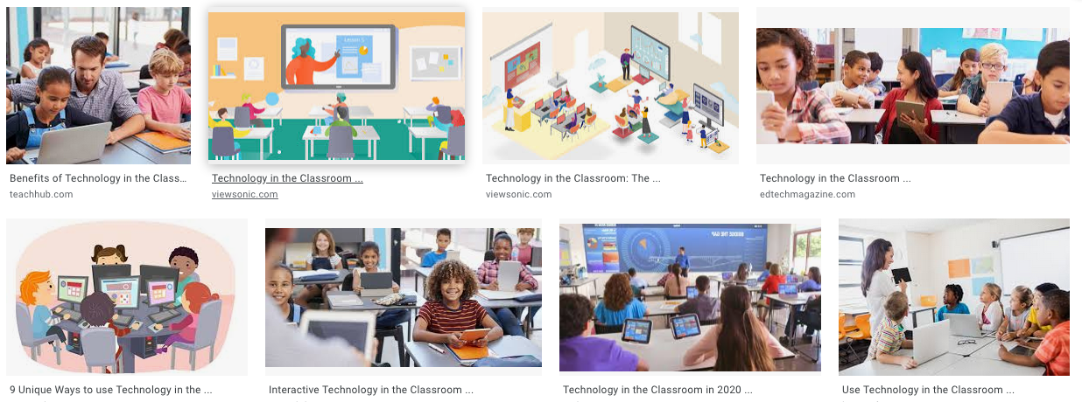
Notes:
Images and videos are also going to give you a different type of response

Slide 8
What can you tell from a URL
http://en.wikipedia.org/wiki/Vervet_monkey/index.html
http => hyper text transfer protocol (type of information being transferred)
en => website name, host name
Wikipedia => second-level domain name
org => top-level domain name
Wiki => root directory of the website
Vervet_monkey => sub-directory name
Index => file name
html => hyper text markup language
Notes:
Have you ever thought about what the various parts of a URL mean? You can usually tell a lot from a URL.
For example you know from a website title what type of organisation is ie .co or .com mean a website is a commercial one and .edu or .ac is used to refer to an educational website.
Have a look at your google search results. How many of the results that were returned in the first page where from commercial websites? 6 of my first ten results were from commercial websites and the rest although they had edu domain names were from organisations that offerd a bit of information (eg a blog or opinion piece or suggestions) but wanted to sell services (like website design, software or educational programs).

Slide 9
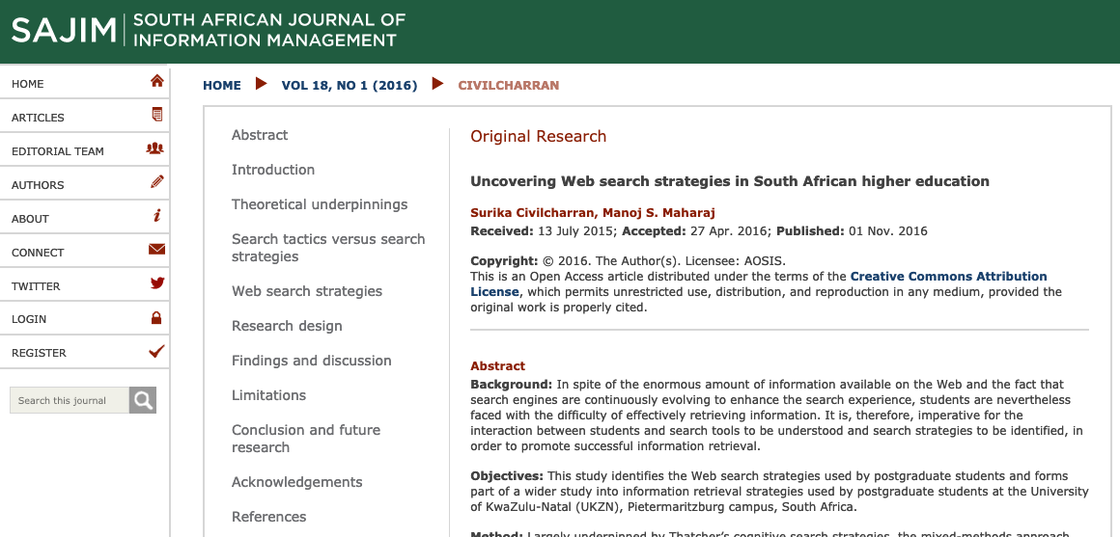
Searching strategies
https://sajim.co.za/index.php/sajim/article/view/698/980
Notes:
I know many of us just search based on the words or phrases we want to know. But what’s useful is to plan Plan your search strategy before actually searching
Here is a very useful open access article about different web searching strategies people use.
Pause here and have a look at the URL – notice the first time you click on the link the website lets you know they are using Cookies and seeks your acknowledgement of that before you continue!

Slide 10
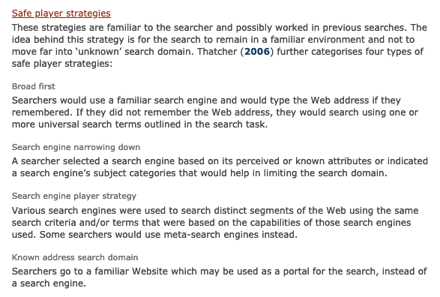
Notes:
The article covers a number of common ways people search online. Do any of these sound familiar to you? When you did your searching for the DEL last week what strategy did you use.
Talk through each of these points

Slide 11
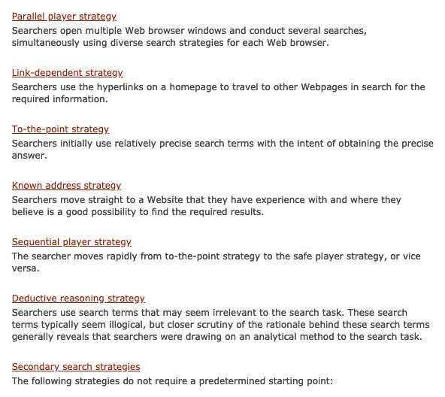
Notes:
These strategies are slightly less common
Talk through each of these points
What this shows is that searching is certainly a very complex approach and many of of us don’t think consciously about how we search online. There are many different approaches we can use and we should try and be aware of what we are doing and what the implications of this are.

Slide 12

Thank You
© Commonwealth of Learning, 2020. Available in Creative Commons Attribution-ShareAlike 4.0 International license to copy, remix and redistribute with attribution to the original source (copyright holder), and the derivative is also shared with similar license.

