Slide 1
Week 1: Recap
C-DELTA Training of Trainers online course

Slide 2
Why is/was unpacking those concepts so important?
And why are those concepts so important to understanding the C-DELTA curriculum?
Notes:
So why is it important to understand these concepts?
Well it’s because they underpin the entire C-DELTA curriculum and as DEL’s yourselves you need to be able to connect practice and experience with theory

Slide 3
Core concepts
Digital Literacy, Identity, Footprint , Networks & Community are core to the approach of the C-DELTA curriculum.
When thinking about our own (or anyone else's) Digital Identity you need to understand the persons (and our own) context
People use of technology is different as a result of their context which means that being a digital education leader is socially situated)
You can’t be a DEL unless you
  Use Technology (well?)
  Have some sort of digital presence
  Are aware of the purpose of your use
Notes:
The view of DL presented in C-DELTA is that people’s use of technology varies depending on their context and needs. There is no such thing as a single DL standard which someone should have to be a DEL.
Yes a DEL needs to be able to use technology but what’s important is the purpose of that use.
What is innovative and appropriate in digital education in one country is not necessarily the same in another. We know our digital practices are different within our family for example. Kids use technology differently to adult and we have probably all had a smile at how our elders use technology as quite often (because they haven’t grown up with it) they use it in different ways to us.

Slide 4
Being a digital education leader
is not an ability it’s a practice
The process of getting to be a DEL is
>> understanding your own digital practices
>> reflecting on your own practices to understand how others are using technology (because their use will be different from your own)
>> understand/reflect on how another persons use of the technology might be influenced/directed by their social norms (i.e. “but all my friends use it that way”) or policy (i.e. Teachers in a school directed to use the LMS/CMS)
>> then support other users of technology in their use of technologies for educational purposes
Notes:
So the process of being a DEL involves being aware of an understanding your own digital practices first and reflecting on what you do digitally.
This should enable you to look explicitly and how others use digital technologies and reflect on why there use is similar or different yours.
This will then put you in a good position to be able to support others to use technology in appropriate ways in order to meet their educational needs.

Slide 5
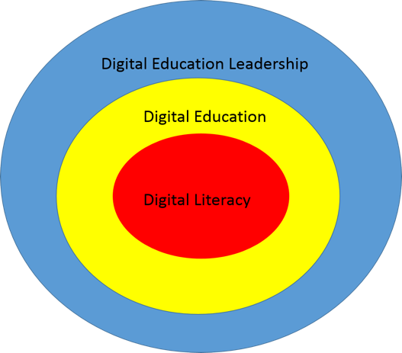
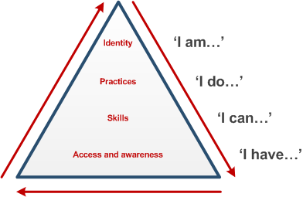
Some visual ways to thinking about DI and being a DEL
“PYRAMID MODEL” OF DIGITAL LITERACY DEVELOPMENT.
Reproduced/adapted with permission from Sharpe & Beetham (2010)
Digital Practitioner Framework reproduced/adapted with permission from Bennett (2014)
Notes:
In the C-DELTA concept document which was written with an expert Advisory Board from across a variety of Commonwealth countries
We drew on two visual representations of DL and DEL.
The left hand model shows at the bottom/lowest level shows that the basis of DL is access and awareness. The next level up (Skills) depicts a user that is showing some competency in their use of technology. Because they have a purpose for example ” I can use email...I can use excel for project management ... Etc”
The “I do” level is nearly there in terms of being a DEL ... “I design learning activities to help my students...I facilitate learning using appropriate technology tools”
The “I am” level is a would be a excellent DEL ... “I am willing to experiment with technology and how it can be used in T&L....I am willing to invest time in exploring and evaluating TEL (Technology enhanced learning)”
And why the red arrows because once you reach the pinnacle you need to repeat the process. As you engage in a practice and acquire an identity you then incease your awareness, need to further develop your skills and then as a result engage in new practices.
Right Image
Shows that being a good DEL requires at it’s core having DL and understanding “digital” as it applies to good education practice

Slide 6

Thank You
© Commonwealth of Learning, 2020. Available in Creative Commons Attribution-ShareAlike 4.0 International license to copy, remix and redistribute with attribution to the original source (copyright holder), and the derivative is also shared with similar license.

