Slide 1
Introduction to C-DELTA
C-DELTA Training of Trainers online course

Slide 2
Welcome Everyone!
Notes:
Welcome to the C-Delta Training of Trainers Online Course.
Lets make a start...and begin with an overview of what C-Delta is all about

Slide 3
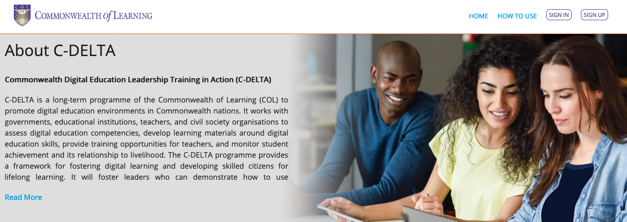
The Commonwealth Digital Education Leadership Training in Action (C-DELTA) project is a programme of the Commonwealth of Learning (COL) that intends to promote Digital Education (DE) in the Commonwealth nations.
But C-DELTA not just about just the promotion of DE -
It IS about producing leaders in the field of DE
Notes:
C-Delta was established by COL 2016
Whats really important about this program is that it not just about promoting DE (although that is certainly one aspect) but about producing leaders in the filed of DE.
Your role as a leader in DE has already been acknowledged as you are a participant in this course. However the goal of the next few weeks is to introduce you to the program, develops your digital literacy/ practices and provide you with tools and strategies to enhance your DEL capability

Slide 4
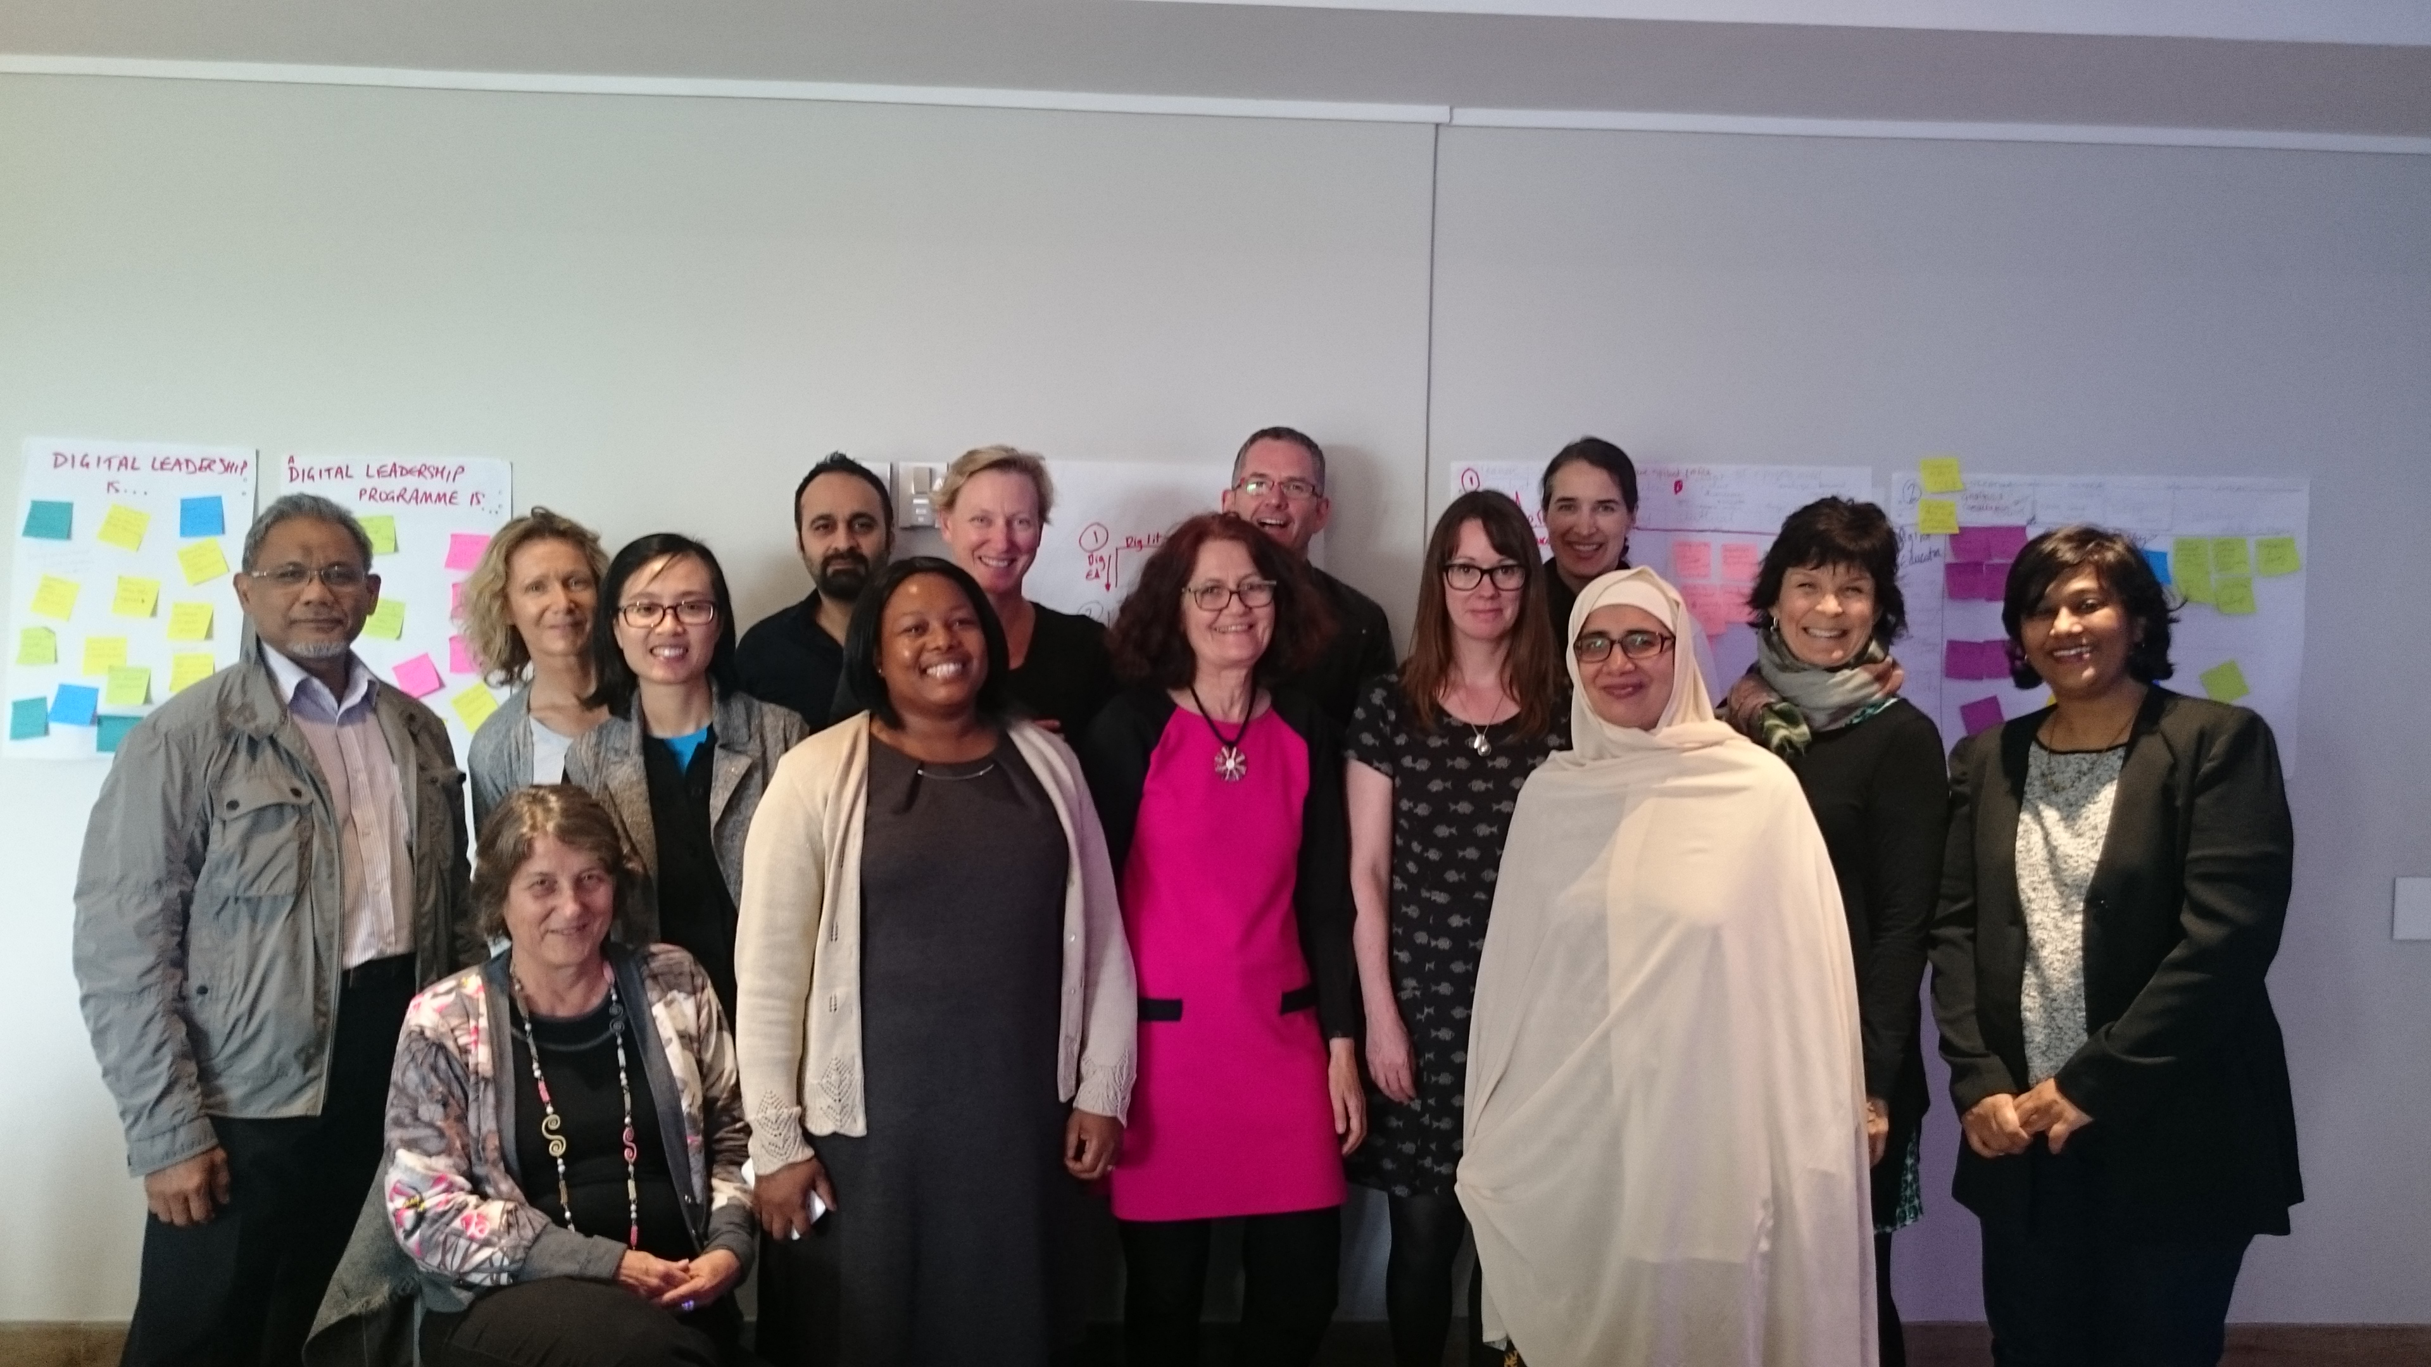
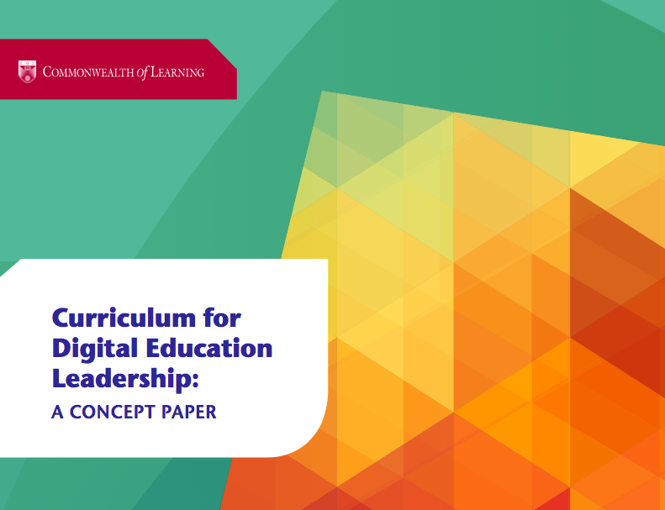
Notes:
COL commissioned a research team based at the Centre for Innovation in Teaching and Learning (CILT), University of Cape Town, to develop a concept paper with the aim of theorising a curriculum framework for digital education leadership
In April 2016, at the start of the program a group of experts and thought leaders from across the commonwealth came together to conceptualize CDELTA.

Slide 5
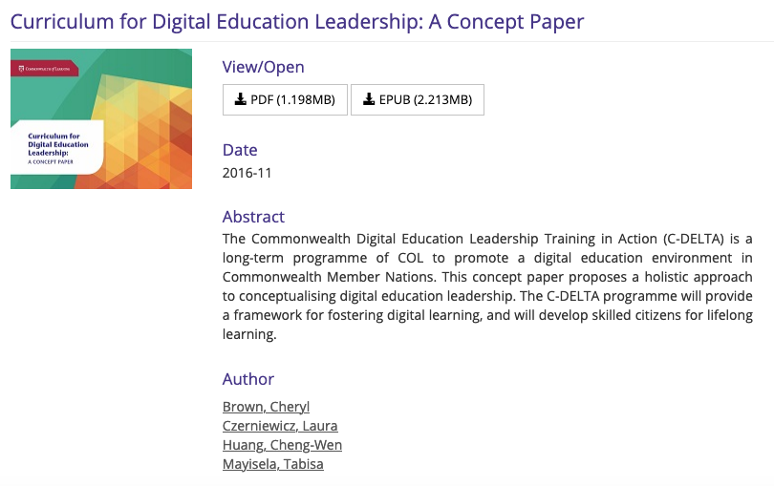
http://oasis.col.org/handle/11599/2442
Notes:
This resulted in the development of a CP. If you are interested in finding out more about whats behind the curriculum you can read more about it on Oasis, COL’s open access repository. Just type C-Delta into the search bar.

Slide 6
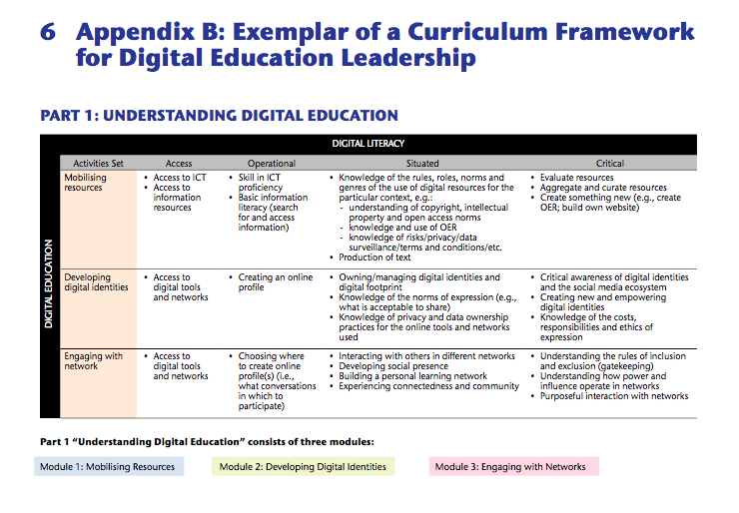
http://oasis.col.org/
Notes:
The paper drew on an extensive literature review of digital literacy, digital education and digital education leadership. It then outlined the motivation for the conceptualisation of the proposed curriculum framework for digital education leadership.

Slide 7
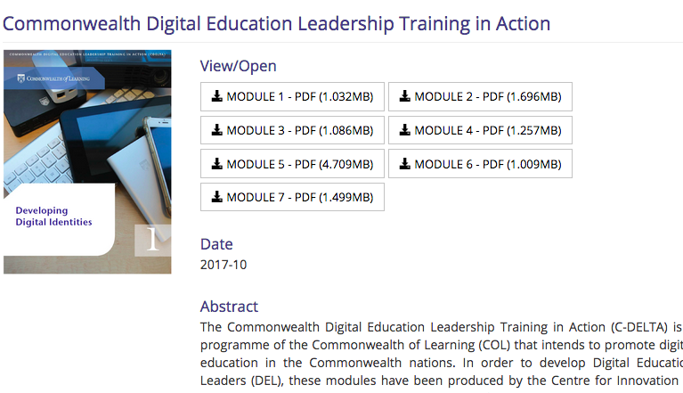
Notes:
This resulted in the production of 7 modules which were originally written in document format
You can view these on the COL oasis platform as well.
One of the principles underlying the program was for them to be accessible to and applicable to people in all education sectors in all countries of the Commonwealth;

Slide 8
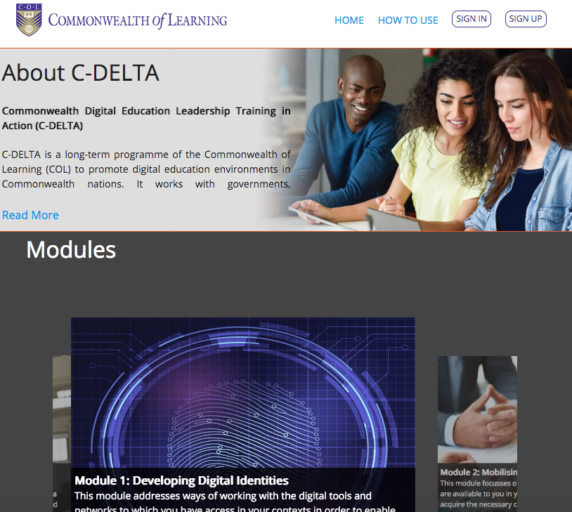
https://cdelta.col.org/
Notes:
https://cdelta.col.org/
As you are aware the modules were developed into a self paced online course and can be access on the website

Slide 9
So, how do you produce leaders in DE?
A curriculum for digital education leadership requires two components: digital education and leadership in digital education, with digital literacies as the basis for both.
The two components for the curriculum framework for C-DELTA has been developed on the assumption that before an individual becomes a digital education leader, that individual must first demonstrate capability in the practices identified with digital education. In other words, the assumption is that a leader should be able to walk their talk and can only lead if they have the necessary knowledge in the “stuff” to be led.
Notes:
So how do you produce leaders in Digital Education.
The philosophy of the program is a DEL needs to not just understand how to use technology but should develop their own set of dgital education practices. They are then able to walk the talk and lead others in developing learning and teaching opportunities using digital technologies that are appropriate for their given contexts

Slide 10
What should you expect over the next 3 weeks?
Notes:
Over the next few weeks the ToT online course
Aims to
to provide you with an introduction to AND experience of the C-Delta modules and activities,
engage you in discussion and activities to help you grow and develop as a DEL
give you opportunity to reflect on and plan how you will move forward as a DEL yourself
This is an orientation to C-DELTA – so will not make you an expert on all aspects of the program. However the modules are available for you anytime to work through and consult

Slide 11
Week 1
S1: Introductions
S2: Activity – Investigating a Digital Identity (DI) (Module 1)
S3: Activity – Unpacking what we found about DI(Module 2& 3)
S4: Activity –Reflecting on our own strategies and online digital literacy (Module 3)
Notes:
We start off the first week with introductions both asynchronously and synchronously and become familiar with the platform
We then explore the concept of digital identity, searching online and issues of privacy and ownership and reflect on our own information seeking approaches and behaviours

Slide 12
Week 2
S1: Access and online resources (Module 4 )
S2: Activity Your own digital footprint (Module 4 )
S3: Activity – Change scenarios (Module 5 )
Notes:
In week 2 we move towards improving your ability to identify, analyse and assess online resources
We will explore permissible use of online resources and use them responsibly as well as issues around equity/inequity of access to resources.
week 2 also will introduce to the COL C-Delta platform and use a case study approach to work through two examples of how people approach change.

Slide 13
Week 3
S1: Reflecting and Engaging with networks (Module 6 -)
S2: Making a contribution (Module 6 & 7 )
S3: Presentation of learning design concepts
S4: Where to from here. Building networks for sustainability (Module 7 )
Notes:
week 3 draws on module 6’s focus on developing networks and designing open and inclusive learning resources. It draws in discussion in module 7 as a focus for reflecting on issues of inequality online.
There is then opportunity to focus on your own context and educational challenges and as future DEL’s plan how you will contribute and become an online content creator.
We end by reflecting on how you, as a group, can mobilise your own networks.

Slide 14


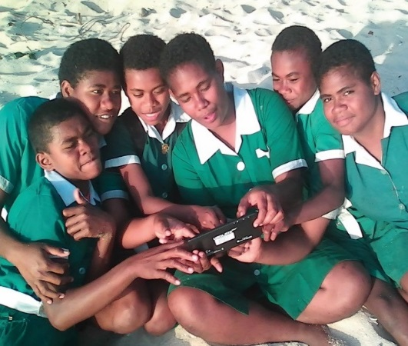
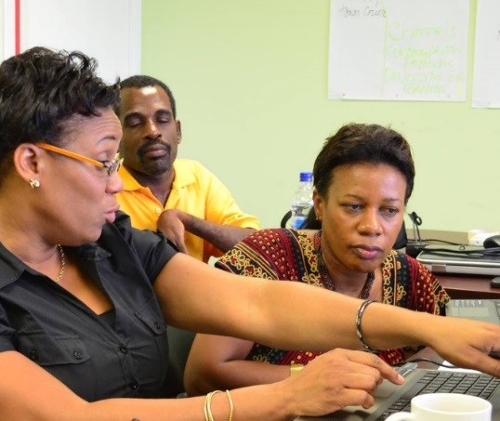
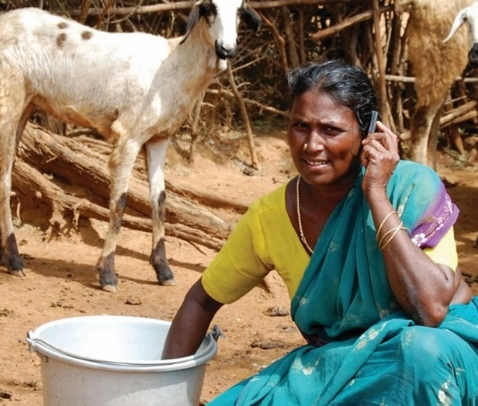
Hope you find the course enjoyable and worthwhile
col.org

Slide 15

Thank You
© Commonwealth of Learning, 2020. Available in Creative Commons Attribution-ShareAlike 4.0 International license to copy, remix and redistribute with attribution to the original source (copyright holder), and the derivative is also shared with similar license.

