Slide 1
eLearning Design
ANALYSIS + DESIGN
Presenter: Melisa Achoko Allela

Slide 2

Scenario
Boyie, the principal, has decided that eLearning is a good option for covering some training needs.
Georgie, the teacher educator, is in charge of initiating and coordinating an eLearning project involving teacher trainers and teachers from various parts of the country. The eLearning initiatives should consider the institutions’ low level of ICT penetration
Georgie needs to know the process to follow and the resources required to develop eLearning content and deliver the course through the Internet.

Slide 3


Formats
Formats
Communication
Self-paced: self-paced and facilitated/instructor-led.
Instructor Led/Facilitated
Synchronous
Time dependent: Chat and Instant Messaging, Video and audio conference, Live webcasting
Asynchronous
Time independent: E-mail, Discussion forum, Wiki,Blog,Webcasting

Slide 4
Components
eLearning content
Collaborative learning
Virtual learning environment
Digital resources e.g. interactive e-lessons, videos, simulations

Slide 5
Instructional Design
‘Learning is facilitated when:
Learners are engaged in solving real-world problems.
Existing knowledge is activated as a foundation for new knowledge.
New knowledge is demonstrated to the learner.
New knowledge is applied.
New knowledge is integrated into the learner’s world
Merrill, D. (2002). First principles of instruction.
Educational Technology Research and Development 50, 3, pp. 43–59

Slide 6
Instructional design
Systematic development of specifications using learning and instructional theory to
‘Learning is facilitated when:
Learners are engaged in solving real-world problems.
Existing knowledge is activated as a foundation for new knowledge.
New knowledge is demonstrated to the learner.
New knowledge is applied.
New knowledge is integrated into the learner’s world
Merrill, D. (2002). First principles of instruction.
Educational Technology Research and Development 50, 3, pp. 43–59

Slide 7
Instructional Design
Good design and planning is critical for successful e-learning projects
carefully crafting learning objectives at a level appropriate for the knowledge and skills that are being developed.
Aligning learning objectives to learning activities and assessment.
designing learning activities that help learners to develop their understanding of the content and to develop the skills that are being taught
Re-use
Notes:
In traditional training, the largest effort is in the delivery of training sessions
, while in e-learning, it is in the design and development of structured materials which must be self-contained and able to be used multiple times without making ongoing adjustments.

Slide 8
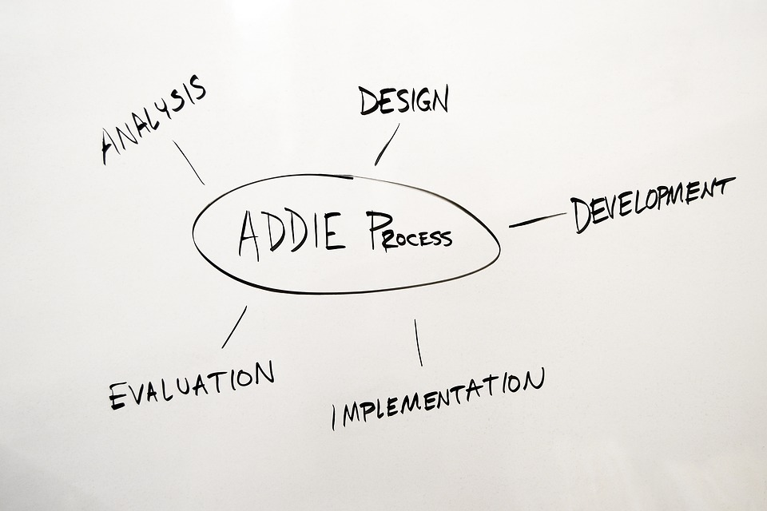
Notes:
a model that describes the different steps in the process of instructional design (ID)
5 phases represent a dynamic, flexible guideline for building effective training

Slide 9
ADDIE
REFLECTION
ANALYSIS
DESIGN
DEVELOPMENT
IMPLEMENTATION
EVALUATION
Needs Analysis,
Target Audience Analysis,
Task/Topic/Content Analysis,
Learning objectives
Sequencing
Instruction strategy
Delivery strategy
Content Development
Storyboard Development,
Courseware development
Self-learning, Collaborative Learning, Support and Management
Feedback , Comments, Learning, Results
Notes:
The analysis and design stages are essential to ensure course effectiveness and learners’ motivation and participation. Analysing learners’ needs and learning content, and finding the appropriate mix of learning activities and technical solutions is crucial to creating an effective and engaging course.

Slide 10


Scenario
“Which topics will the course cover? And in which order?”
Issa the teacher educator and Petra, the Instructional Designer, are brainstorming about which topics to cover in an eLearning course aimed at English Language teaching.
Petra asserts that there are several crucial topics – ranging from listening for pronunciation practice to listening for communication purpose– that are relevant to the course objective. However, not all of them can be covered by a single course and probably not all of them are really needed.
Petra suggests a few methods to prioritize the content and organize it into a logical flow.
LEARNER CENTERED
“what do you want my students to learn?
“what do you want students to be able to do at the end of this course”

Slide 11
Specify clear learning objectives
Select content
Develop learning activities
Develop assessment activities
Develop microlearning objects
aligned and all contribute to the achievement of those learning objectives.
Notes:
Specify clear learning objectives
Select content
Develop learning activities
Design assessment activities that are all aligned and all contribute to the achievement of those learning objectives.

Slide 12
1. Analysis
TARGET AUDIENCE (Learner Characteristics)
CONTEXT ANALYSIS
TASK AND TOPIC ANALISYS

Slide 13
Task: Learner Characteristics
Describe yourself as a learner in five key words (or wordings),
e.g. ‘I learn best when…’, ‘I cannot learn without…’, ‘I am a … learner’, ‘Learning for me means…’,
Picture yourself as a learner in one image, cartoon, photo,…
Explain the words and the picture to your neighbour, and vice versa
Discuss with your neighbour:
  Which characteristics do you have in common?
  What are striking differences?
Make a class picture

Slide 14
Prior knowledge
Motivation
Expectations
Group characteristics
Background
Level of self regulated learning
…

Slide 15

Digital natives
ICT-minded
Multitasking
Media literate
A-linear, a-synchronous
Explorative, interactive
With a positive attitude
Target oriented
Social, connected
As partners with educators
…

Slide 16


Slide 17


Slide 18
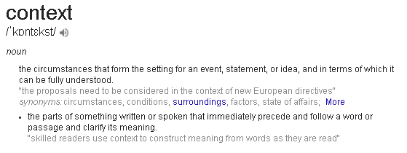
Context Analysis
Accessibility
Mobility
Size of the group
Infrastructure
Culture
Resistance to technology

Slide 19


Slide 20
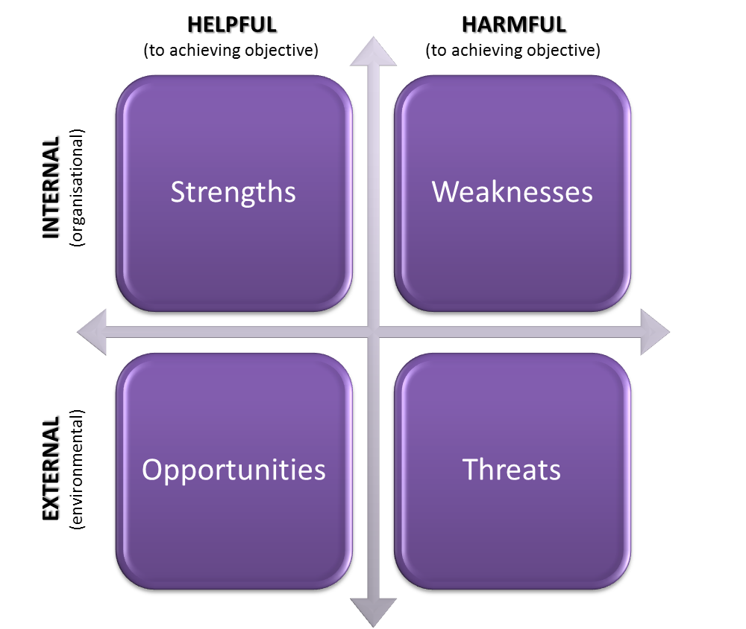
Task
Make a SWOT-analysis of your own (learning) context

Slide 21
SWOT
Relevance of the content and course objectives for the learner
Do they meet existing needs?
Type of learning activities offered by the course
are they interesting, inspiring and well-matched to the level of the participants?
Course duration, timing and number of hours to be invested
do they fit with the participants’ availability?
Technical aspects
is the technical solution appropriate to learners? Are the technical elements (e.g. the learning platform and its functions) clear and understandable to participants?

Slide 22
2. Design
Teaching Methods
Learning Activities

Slide 23

Reflection
Which teaching methods do you use?

Slide 24
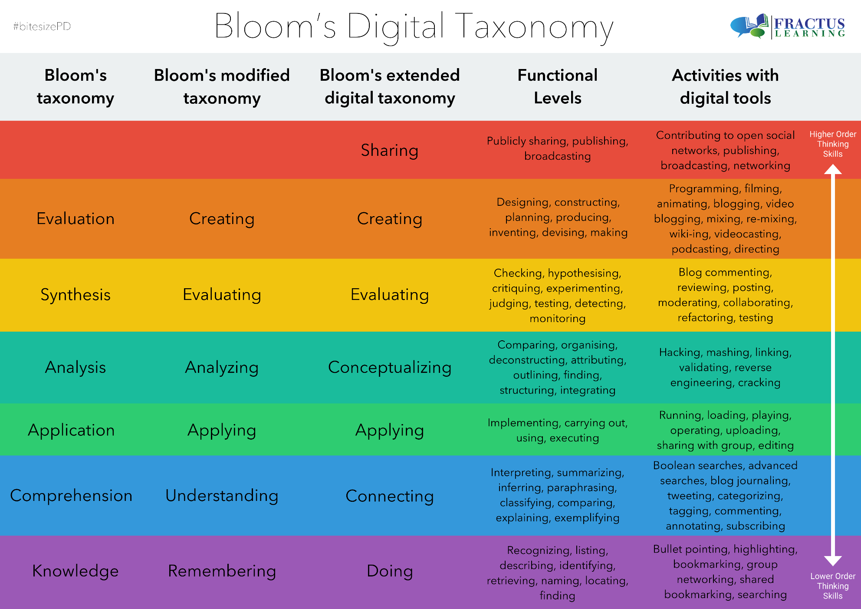
Disseminating learned information
Putting elements together to form a new function whole
Make judgements based on criteria or standards
Break concepts into parts, determine how parts interrelate
Use learned information
Constructing meaning from different forms
Memory to recollect facts, produce definitions, retrieve material
Notes:
Learning activities
About using technology and digital tools to facilitate learning. (Developed by Andrew Churches, based on the updated Blloms taxonomy)

Slide 25
Reflection (Journal entry)
Which teaching methods are you using in your course?
Which teaching methods do you want to use in your project/course?
Can you imagine an appropriate teaching method for each level in the Bloom’s digital taxonomy?

Slide 26
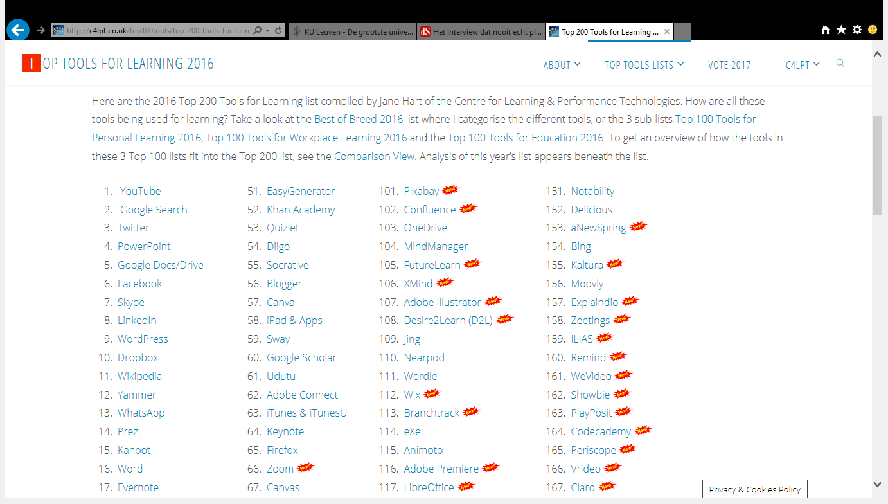
Top tools for learning

Slide 27
Learning activities | Teaching method | Media/tools
Instruction: T presents, S listen | Lecture Demo | Audio/video recordings Screencasting Webcolleges Video communication
Interaction: T interacts/ communicates, S communicate with each other | Brainstorm Discussion Debate Role play | Mindmapping Forum Weblog Edugames Virtual world Video communication
Collaboration : T guides / coaches S work together | Project Group work | Virtual classroom Collaborative workspace Social media ePortfolio

Slide 28

Questions?
Suggestions?

