Slide 1
Introduction to Microlearning
METHODS & TECHNOLOGIES
Presenter: Melisa Achoko Allela

Slide 2

Microlearning object serves a specific objective, the forms they take are diverse and dependent on the intended learning outcome.
Notes:
Since each microlearning object serves a specific objective, the forms they take are diverse and dependent on the intended learning outcome.

Slide 3
Videos
Include only one learning objective per video
Storyboards and Script
Use visually descriptive content
Use audio effectively
Employ the right production tools

Slide 4
Tutorial: Creating Videos from PowerPoint Presentations
Use the provided PowerPoint template and follow the steps provided to create you own Voice-over-PowerPoint Presentation.
Discuss and share results within the group.

Slide 5
Interactive Presentations
Choose the ideal authoring tool.
Change the default layouts e.g. alter backgrounds, include clickable links to outside resources, or add additional relevant and attention-grabbing graphics to make it more exciting. Refer to the templates that have been provided for commonly used tools such as PowerPoint and Articulate.
Make navigation non-linear and add menus at the beginning or the presentation for ease of navigation.
Add hyperlinks and integrate videos (see previous section on videos).
Add characters and audio to make your content immersive.
Add stories (that could link to real world scenarios)

Slide 6
Tutorial 2: Creating an Interactive Presentation
Use the provided PowerPoint template to create a simple micro-assessment exercise.
Discuss and share results within the group.

Slide 7
iPDFs
Creating awareness about a topic and not building skills and competency;
Relaying quick communication within a short time-frame;
Learning does not require assessment or scoring such as in a LMS;
Are useful as reference material that supports larger training.

Slide 8
Animation
In explaining abstract concepts
Improving information retention
Engaging learners
Making content relatable
To surprise and delight learners
To improve attitudes towards training
To emphasize visual metaphors, rhetoric and didactics.

Slide 9
Animation
Write a Script
Tell a Story
Use the Right Tone (Conversational Tone)
Avoid extraneous information
Use Different Media
Seek Different Perspectives
Test your storyboard (rough mockup of your animation)

Slide 10


Slide 11
Infographic
Chunking content
Format
Visual design
Call-to-action

Slide 12
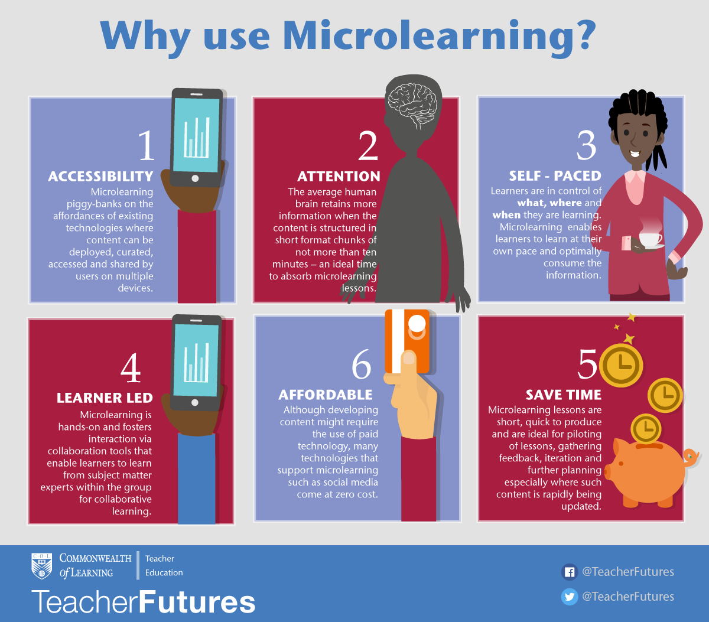

Slide 13
Social Media
Encourage learners to comment (react, like, share) or rate the microlearning objects. Additionally some platforms such as Facebook allow you create polls where you can poll the efficacy of a resource.
Compel learners to talk about what they are learning, exchange ideas and engage in discussions related to the microlearning object.
Encourage learners to ask questions related to the training to reinforce learning.
Encourage curation of learner-created microlearning object.
Provide forums for support and responding to queries by learners.
Notes:
According to the Oxford dictionary, the term “social media” can be defined as websites and applications that enable users to create and share content or to participate in social networking. Essentially, this means that the internet and its tools can be used to communicate in new, constructive and collaborative ways, enabling us to work together and communicate remotely - at the same time, or at different times.
Social media platforms such as Facebook, LinkedIn Twitter and WhatsApp enable social learning i.e. learning with and from others. It facilitates a personal experience since learning is not taking place in conventional formal learning environment. Furthermore, the bite-sized communication that takes place on social media platforms characterized by a preference for smaller pieces of information is very much aligned with microlearning. Content can be easily accessed and shared across multiple devices using features such as chat, comment share, like etc.

Slide 14
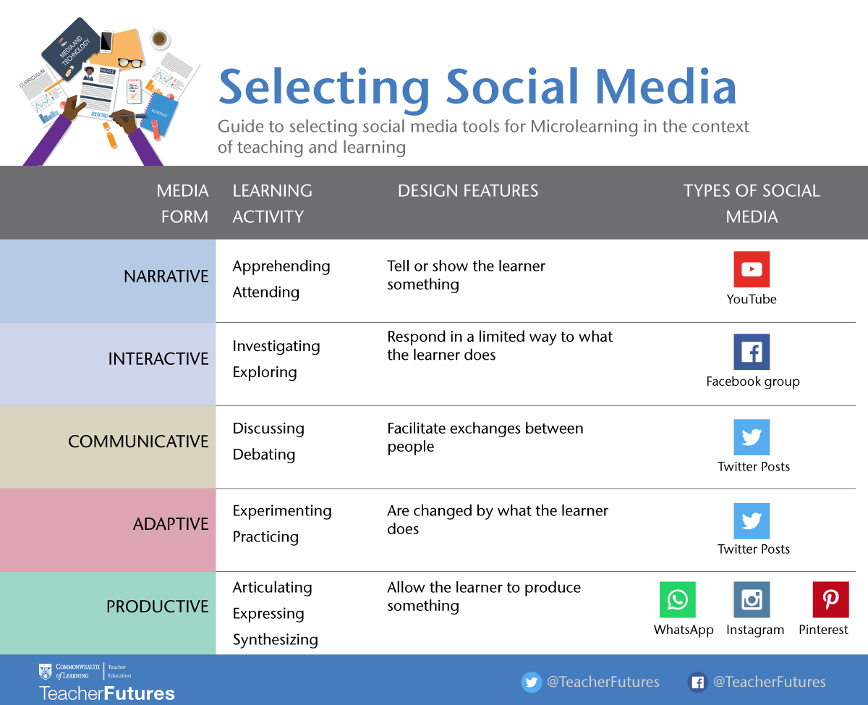

Slide 15
Pedagogical contexts
For Teaching
Blogs: share introductions and other induction activities
Wikis and Google Drive: project collaboration
Google hangouts : group online meetings
YouTube videos: how to guides
Screencast tools: e.g. Jing and Screencast-o-matic to create short summaries
Pinterest: visual reading lists
Diigo: social bookmarking
Academic Professional Development
Sharing information via Twitter and LinkedIn
Discussion forums such LinkedIn groups and Google+ communities
Curation tools to gather resources on specific topics e.g. Scoop.it
Peer Support
Facebook: Maintain/make new connections/friendships
Course blogs: share interests, hobbies etc.
Collaborative Pinterest boards: share inspirational quotes or picture quizzes of places and people in University
Online group chat using Google+ hangouts, Skype or Blackboard Collaborate
Notes:
Add more

Slide 16
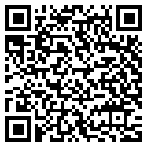

Print-based resources
Links to online repositories
Embed audio files
The traditional way of integrating multimedia into a printed material was to provide a URL which the learner could type into a browser. With more complex URLs, this becomes a tedious and inefficient task.
The Print2Screen App allows learners to access multimedia components, such as videos, referred to in a printed material through the use of a mobile phone or tablet.
Notes:
The learners will just need to open the app and point it to the relevant section in the printed material to view the multimedia resources on the phone. The app will also keep track of their use of learning resources, store links to the resources on the device, enable them to add study notes and share the resource on social media.

Slide 17
Tutorial: QR codes in print-based resources
Download beta version of Print2Screen app
Use any free QR code generator (e.g. http://www.qr-code-generator.com/ )
Generate and embed QR code into your print based resource.
NB: Adhere to the below format
Resource URL; Title of resource; Notes (e.g. brief descriptions. Questions etc.)

Slide 18
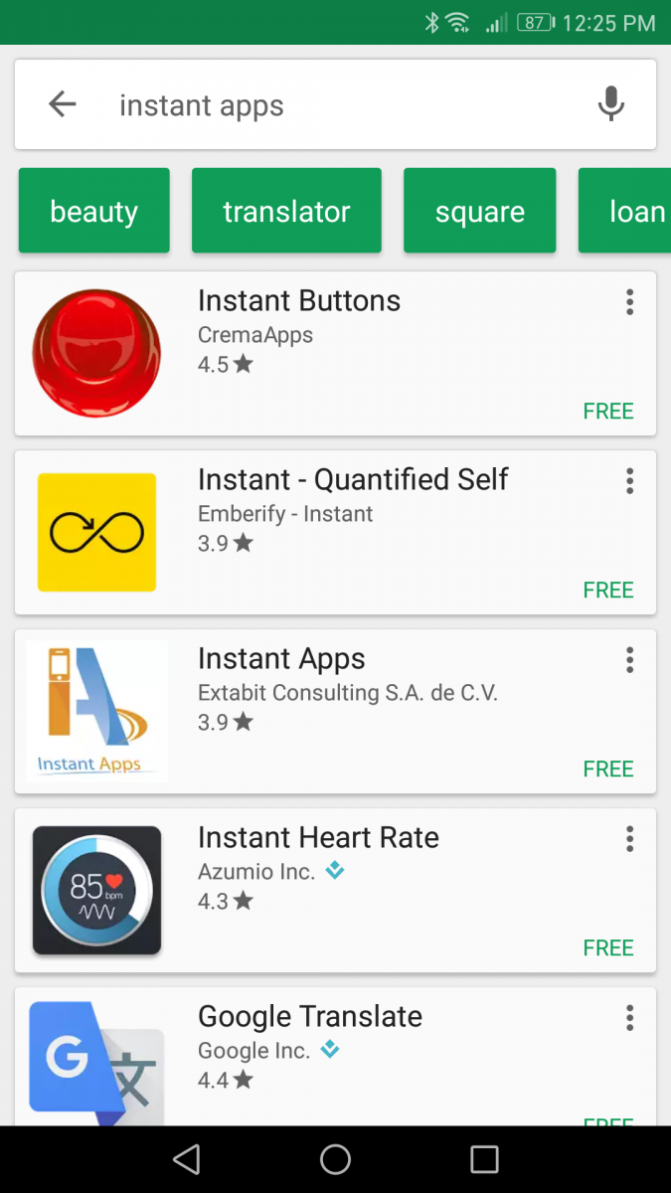

Step 1
Print2Screen
Using your phone, go to the Playstore and search for Print2Screen App.
Click install to install the app.

Slide 19
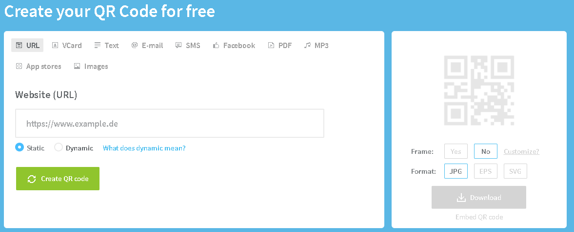
Step 2
Go to this web address to create your QR code: http://www.qr-code-generator.com/

Slide 20
Step 3
NB: Adhere to the below format while pasting your url
Resource URL; Title of resource; Notes (e.g. brief descriptions. Questions etc.)
Below is an example:
https://youtu.be/4o2Z_0r_zJA; Inclusion matters. There is ability in disability; Sixty Kamara explains how he will seek out stories that focus on how Sierra Leone is dealing with life

Slide 21
Step 4
Download the generate QR code and insert it in your print material.
Use the Print2Screen App to scan the resource.

Slide 22
List of compatible websites
1. https://www.col.org/
2. http://cemca.org.in/
3. http://oasis.col.org/
4. https://www.youtube.com
5. https://vimeo.com/
6. http://nptel.ac.in/
7. https://commons.wikimedia.org
8. https://www.flickr.com

