Slide 1
Introduction to Microlearning
DEFINITION & BENEFITS
Presenter: Melisa Achoko Allela

Slide 2
Overall aim
By the end of this session, participants will be able
To understand the concept of microlearning and apply this to develop their own individual content
to use mobile technology to produce print based microlearning materials
to integrate the technological, pedagogical and content knowledge to produce microlearning objects
AIM: Using mobile technology to promote microlearning, as well as, stimulate peer collaboration through networked learning and Communities of Practice (COPs).
Notes:
Short-term memory
Working memory

Slide 3
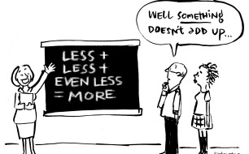

Slide 4
Memory
Read the list only, concentrating briefly for a few seconds on each word.
Vase | Teapot
Tiger | Camera
Book | Ice Cream
Cushion | Spade
Piano | House
Hat | Orange
Notes:
Here is a small task. Moments later you will realize that you have completely forgotten that the full list of words. The information is quickly lost from short-term memory when you fail to rehearse or repeat the information.

Slide 5
Memory
How many words can you recall?
Score between 5-9 is the average capacity
Notes:
Harvard-based psychologist George A Miller found that in our short term memory, the average number of 'chunks' of information (names, numbers, etc) that can be stored is 7, + or - 2.
This means that if you scored between 5 and 9 of the words on the list, your short term memory is working at an average capacity,
but you can improve it using a number of techniques which we'll explore later.
Stores information for about 20 – 30 seconds
After which information is either committed to long-term memory or forgotten altogether

Slide 6
Working memory
Learning is the process of acquiring new information in your working memory and integrating it with existing information in your long term memory.
Once in the long-term memory, you can recall and apply it to the real world.
Notes:
Learning is the process of acquiring new information in your working memory and integrating it with existing information in your long term memory.
The average human brain stores information for about 20 – 30 seconds. After which information is either committed to long-term memory or forgotten altogether.
And this is where working memory comes into place. The processes that are used to temporarily store, organize and manipulate information.
Once in the the long-term memory, you can recall and apply it to the real world.

Slide 7
Cognitive load
Total amount of mental effort being used in the working memory
Extraneous material ‘distracts, disrupts. Seduces.’
Harp and Mayer 1998
The coherence principles means avoid adding any material that does not support the instructional goal
Clark and Mayer 2011

Slide 8
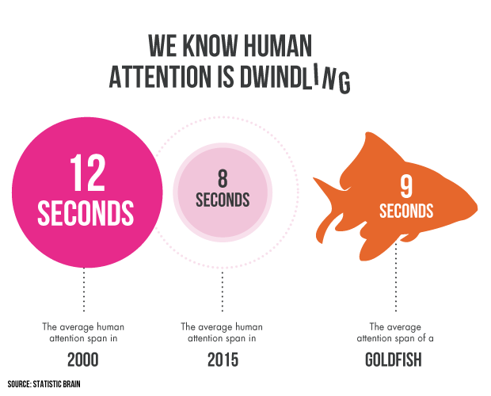
Notes:
Research indicates that microlearning matches our brain’s limitation of working memory by combating learner boredom, disengagement, and poor retention that is attributed to cognitive overload as a result of more traditional long-format instruction.
Studies indicate that over the last decade, the average human attention span has been dropping. It is now at 8.25 seconds, less than that of a goldfish. But this is in essence is myth since there is no one universal definition of ‘attention span’ and actual research on goldfish memory indicates otherwise. But this hints at the fact that we have become a population of demanding, selective and choosy skimmers.

Slide 9
Characteristics
Low time commitment
Small chunks
Short effort
Narrow topics (part of a complex whole)
Method of training involving short, bite-sized, digestible, well-planned learning activities that learners can consume via digital media.
Notes:
Microlearning is a relatively new paradigm in teaching and learning, and training in general.
Although there is no one accepted definition for microlearning, it generally refers to a method of training involving short, bite-sized, digestible, well-planned learning activities that learners can consume via digital media.

Slide 10

Notes:
We engage with microlearning on a daily basis, by reading a post on social media, emails, text messages, or simply looking up information on a search engine such as Google. Information has become ubiquitous and we are now constantly connected to the latest happenings via our mobile devices. This connectivity is significantly affecting how we work, learn and communicate. The mix of technology and and constant access thus creates this enabling environment for microlearning.

Slide 11
Microlearning is…
Single Focused: Targets single performance, or knowledge
Single Activity: Uses a single learning activity to achieve that objective.
Modular: Tied to a larger. Easy to design, produce, update and organize
Accessible: mobile devices, laptops, phones
Flexible: Learners can view or skip specific content
Holistic: Learners to get a full view of a topic.
Recursive: Learners attain a broad view of content before focusing on individual parts

Slide 12
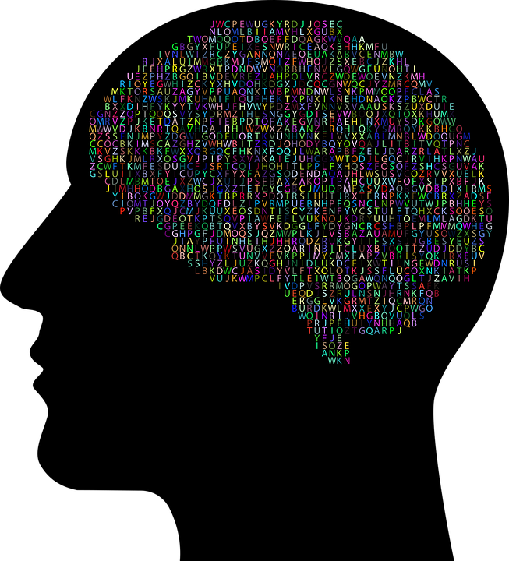
Reduce cognitive overload
The average human brain retains more information when the content is structured in short format chunks of not more than ten minutes – an ideal time to absorb microlearning lessons which are part of a larger learning track.

Slide 13

Varied Environments
Learning can take place in informal learning environments, outside of formal learning environments but in mediated digital spaces
Does not follow a specific curriculum
Spontaneous

Slide 14

Self-paced, Just-in-time
Learner controls the pace at which they consume the content. Learners are in control of what, where and when they are learning and consume the content as often as they wish. Competence can be evidenced through microlearning assessments at the end of each module.
Learners can easily access specific kinds of contents, at a specific time of day.
Notes:
Microlearning enables learner to learn at their own learning pace and in so doing optimally consume the information.

Slide 15

Learner-led
Hands-on, fosters interaction via collaboration tools that enable learners to learn from subject matter experts within the group or leverage on the strength of the crowd for collaborative learning.

Slide 16

Mobile-friendly
Piggy-backs on the affordances of existing web-technologies and new trends in eLearning and educational technology.
Content can be deployed, curated, accessed and shared by users on multiple devices and can be implemented in any learning environment
Learners use tools that they are already accustomed to and the tools leverage on pre-existing user behaviour.
Notes:
In such a scenario, learners also become content creators through the possibilities of responding to questions on social forums, blogs and providing feedback to other learners within a community of practice.
In addition, well designed microlearning strategies can vary the modes of delivery to address learners multiple intelligences resulting in highly personalized experiences.

Slide 17

Cost savings
Quick to produce, enable piloting of short lessons, gathering feedback, iteration and further planning for additional lessons especially where such content is rapidly being updated.
Notes:
In such a scenario, learners also become content creators through the possibilities of responding to questions on social forums, blogs and providing feedback to other learners within a community of practice.
In addition, well designed microlearning strategies can vary the modes of delivery to address learners multiple intelligences resulting in highly personalized experiences.

Slide 18
Not suitable for...
Task that require complex technical skill building
Novice learners

Slide 19
Examples
APPS
Print2Screen
audio books (Audible)
Twitter
Flashcards
Duolingo
VIDEOS
Brief videos
Interactive videos
Question and response
Learner recording a brief audio in response to a question
Short quizzes and polls
Infographic
Activity notifications from online communities of Practice
Challenge type interactive documents
GAMES
Immersive micro-learning simulations that last between 5 -20 minutes.

Slide 20

Questions?
Suggestions?

