Slide 1

eLearning Design
INTRODUCTION
Presenter: Melisa Achoko Allela

Slide 2
eLearning
The use of information and communication technologies (ICTs) to expand access to education and to enhance and transform teaching and learning.
Issues in E-Learning & Distance Education Video Series www.col.org/videos What is eLearning?
Notes:
the use of computer and Internet technologies to deliver

Slide 3
eLearning continuum
Face-to-Face
Blended Learning
Online/Distance Learning
technology is used primarily to enhance the face-to-face teaching
technology is used to deliver teaching and facilitate learning
technology is used to replace face-to-face teaching
Issues in E-Learning & Distance Education Video Series www.col.org/videos What is eLearning?
Mark Bullen
Notes:
the use of computer and Internet technologies to deliver

Slide 4

eLearning and Open Education
Open education is based on the idea that:
“knowledge should be free and open to use and reuse; that collaboration should be easier, not harder; that people should receive credit and kudos for contributing to education and research; and that concepts and ideas are linked in unusual and surprising ways and not in the simple linear forms that today’s textbooks present”.
Richard Baraniuk
Co-Founder Open Education Movement
Notes:
Baraniuk is one of the founders of the Open Education movement
Open education has the potential to radically change education by promoting and facilitating the sharing and reuse of educational resources and pedagogical practices and by making this all freely available to anybody who has Internet access.
Openly licensed content can be produced in any medium: paper-based text, video, audio or computer-based multimedia.

Slide 5

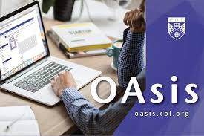



eLearning and Open Education
Open Resource for English Language Teaching
freely accessible
openly licensed documents and media that are useful for teaching, learning, and assessing as well as for research purposes.
http://www.goopen.no/timeline/
Notes:
Baraniuk is one of the founders of the Open Education movement
Open education has the potential to radically change education by promoting and facilitating the sharing and reuse of educational resources and pedagogical practices and by making this all freely available to anybody who has Internet access.
Openly licensed content can be produced in any medium: paper-based text, video, audio or computer-based multimedia.

Slide 6

eLearning and Adult Learners
need to know the benefits of learning (why they have to learn something)
like to learn experientially
approach learning as problem-solving
learn better where they can see the immediate value and application of content
prefer to study at a time, place and pace convenient for them
Notes:
need to know the benefits of learning (why they have to learn something)
like to learn experientially
approach learning as problem-solving
learn better where they can see the immediate value and application of content
prefer to study at a time, place and pace convenient for them

Slide 7

Scenario
Idris is a principal at a local Teacher Training College. The college provides training to Junior Secondary School teachers from several parts of the country.
Because of the increasing demand to change the teacher trainers’ methods of lesson delivery to the more effective student-centred, activity-based and technology-supported teaching/learning experiences, Idris is considering the option of including e-learning in the College’s training plan.
He now would like to know if e-learning is a convenient option for the Teacher Training College, and if it can ensure the same effectiveness as traditional training.

Slide 8
Why eLearning?
Just as effective as traditional training at a lower cost
Can reach a wider target audience who have challenges attending conventional classroom training (location, limited time, busy with family/work commitments, restricted in mobility)
Offers effective instructional methods (associated feedback, collaboration activities, self-paced study, personalizing learning paths based on learners’)
Notes:
geographically dispersed with limited time and/or resources to travel; > busy with work or family commitments which do not allow them to attend courses on specific dates with a fixed schedule; > located in conflict and post-conflict areas and restricted in their mobility because of security reasons; > limited from participating in classroom sessions because of cultural or religious beliefs; > facing difficulties with real-time communication (e.g. foreign language learners or very shy learners).

Slide 9
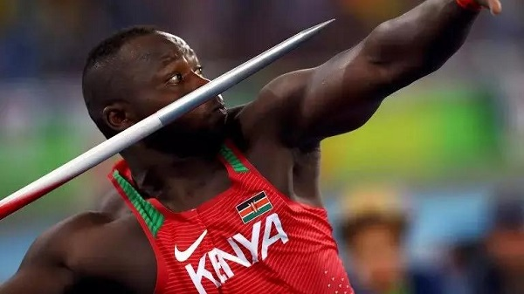
Why eLearning?: Learning Domains
“There were no coaches to guide me. I was just alone in the field, training. My father wanted me to give up javelin. Everybody here in Kenya is a runner. I took that as a challenge to find another way to succeed. I started watching videos... I could see that training like these people could improve me”
World Javelin Champion “Mr. Youtube man” Julius Yego,
CNN interview 2013
Source: Kenya Broadcasting Corporation
Notes:
“There were no coaches to guide me. I was just alone in the field, training. My father wanted me to give up javelin. Everybody here in Kenya is a runner. I took that as a challenge to find another way to succeed. I started watching videos... I could see that training like these people could improve me” he said during a CNN interview in 2013.

Slide 10
Learning Domains
eLearning
Face-to-face
Cognitive
Affective
Psychomotor
Interpersonal
Intellectual skills
Procedural Knowledge(Recall), Comprehension, Application, Analysis, Synthesis, Evaluation
Graphs, Presentations, Discussion forums, Graphics, Case studies, Drill and Practice, Animation, Simulations etc.
Attitude and Motivation
Willingness to listen, participate, get involved, become an advocate, change one’s behavior, lifestyle, or way of life.
Tips from practitioners, former students, explaining content
Motor + cognitive skills
movement, coordination, manipulation, dexterity, grace, strength, speed
Lab courses, Vocational courses, Physical education courses, training in using specified equipment such as computers, cameras, musical instruments , Performing arts
People skills
Listening, Negotiating, Disagreeing, Decision making, Supporting, Compromising
seeing models, practicing the skills, and getting feedback in the form of coaching
DELIVERY
Notes:
Most e-learning courses are developed to build cognitive skills; the cognitive domain is the most suitable for e-learning. Within the cognitive domain, thinking skills may require more interactive e-learning activities because those skills are learned better “by doing”. Learning in the interpersonal domain can also be addressed in e-learning by using specific methods. For example, interactive role playing with appropriate feedback can be used to change attitudes and behaviours.
Learning domains/categories of lear
ning outcomes
Lab courses for science classes
· Vocational courses
· Physical education courses
· Training in using specified equipment such as computers, cameras, musical instruments etc.
· Performing arts
Former students giving tips on how to be successful
· The instructor informing the students of the value of the course
· Professionals who are using the knowledge from the course in their lives
· An overview of the program with key support personnel and facilities visible to the student
· Streaming audio files throughout the course encouraging students and providing helpful tips
· Short video clips of the instructor explaining course content

Slide 11
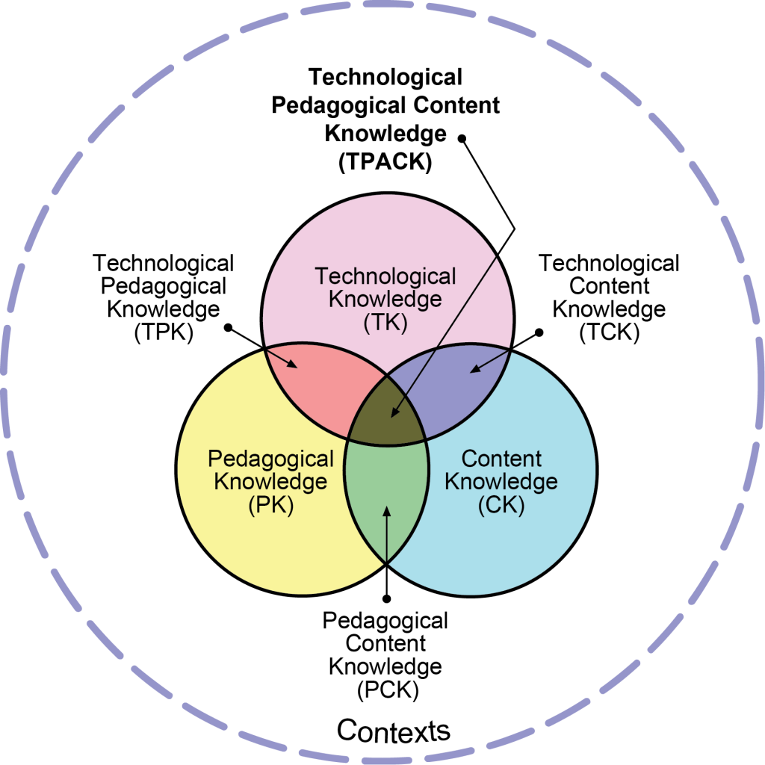
TPACK
reproduced by permission of the publisher, © 2012 by tpack.org
Notes:
Technological Pedagogical Content Knowledge (TPACK), attempts to capture some of the essential qualities of knowledge required by teachers for technology integration in their teaching, while addressing the complex, multifaceted and situated nature of teacher knowledge. At the heart of the TPACK framework, is the complex interplay of three primary forms of knowledge: Content (CK), Pedagogy (PK), and Technology (TK).

Slide 12
TPACK Explained
Content Knowledge (CK) – Knowledge about the subject matter to be learned or taught.
Pedagogical Knowledge (PK) – Knowledge about the processes and practices or methods of teaching and learning.
Technology Knowledge (TK) – Knowledge about certain ways of thinking about, and working with technology, tools and resources.
Pedagogical Content Knowledge (PCK) – Knowledge of pedagogy that is applicable to the teaching of specific content.
Technological Content Knowledge (TCK) – Knowledge of the manner in which technology and content influence and constrain one another.
Technological Pedagogical Knowledge (TPK) – Knowledge of how teaching and learning can change when particular technologies are used in particular ways.

Slide 13
TPACK Definition
Basis of effective teaching with technology
Requires an understanding of the representation of concepts using technologies;
  pedagogical techniques that use technologies in constructive ways to teach content;
  knowledge of what makes concepts difficult or easy to learn and how technology can help redress some of the problems that students face;
  knowledge of students’ prior knowledge and theories of epistemology;
  knowledge of how technologies can be used to build on existing knowledge to develop new epistemologies or strengthen old ones.
(Koehler & Mishra, 2009)

Slide 14
When to use eLearning
Learning Domain: training aims to build cognitive skills rather than psychomotor skills;
Large Class sizes: Large amount of content to be delivered to a large number of learners;
Location: learners from geographically dispersed locations;
Time constraints: learners have limited mobility, limited daily time to devote to learning;
Technical skills: learners do not have effective listening and reading skills; learners have at least basic computer and Internet skills;
Learner Motivation: learners are highly motivated to learn and appreciate proceeding at their own pace; content must be reused for different learners’ groups in the future;
Analytics: there is a need to collect and track data.

Slide 15

Questions?
Suggestions?

